Slide 1


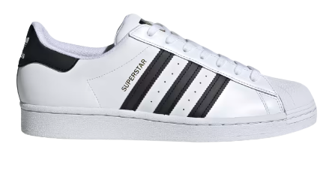
Adidas US Sales Analysis Using SQL
By Daniel Uzomah

Slide 2
The slides below shows different queries used to extract answers relevant to each problem statement.

Slide 3
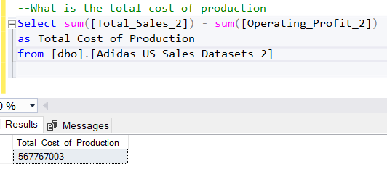
Total cost of production

Slide 4
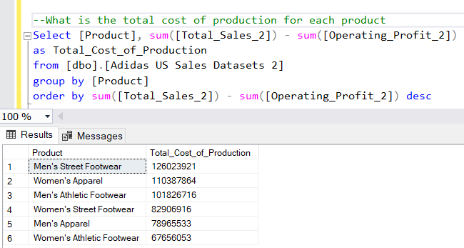
Total cost of production for each product

Slide 5
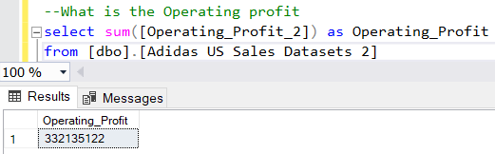
Total Operating profit

Slide 6
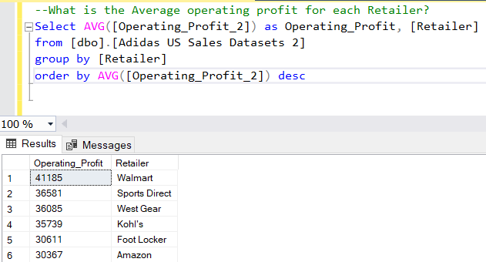
Average Operating Profit for each retailer

Slide 7
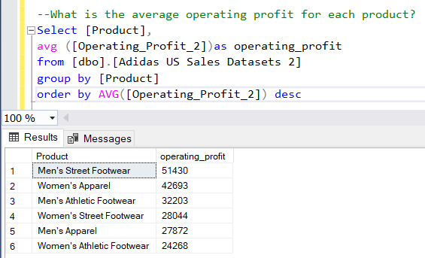
Average Operating Profit by Product

Slide 8
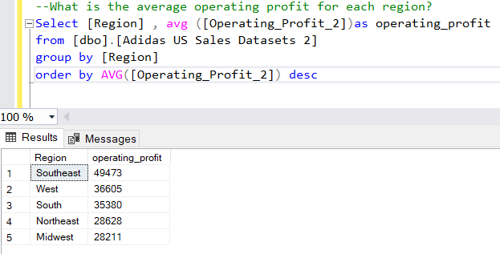
Average Operating Profit for each region.

Slide 9
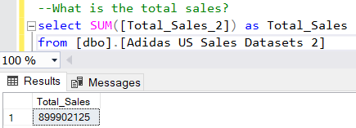
Total Sales

Slide 10
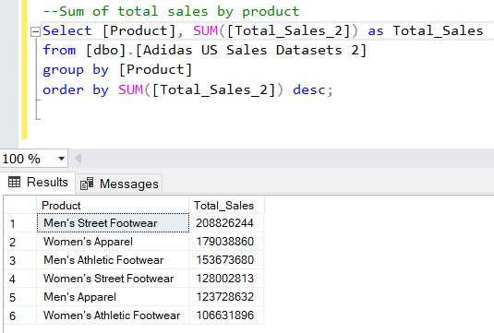
Total Sales for each Product

Slide 11
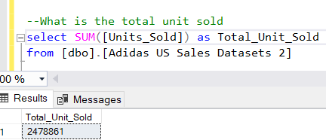
Total Unit Sold

Slide 12
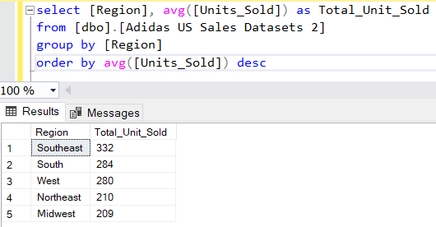
Average unit sold for each region

Slide 13
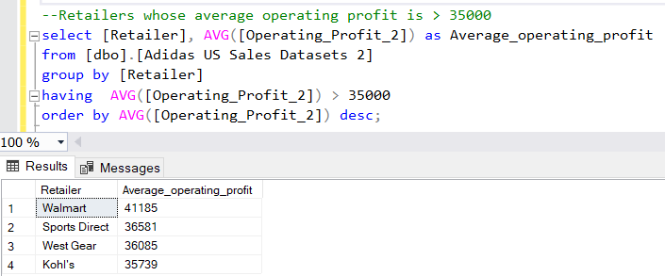
Retailers whose operating profit is > 35000

